Slide 1
From Tangra 3 to OccultWatcher via AOTA - Measurement, Analysis and Reporting
Hristo Pavlov
TTSO8, Melbourne, 21 Apr 2014
Notes:
[2:15 – 2:16] The new version of Tangra comes with a large number of improvements including an integration with AOTA and OccultWatcher for a full end-to-end solution for measurements, analysis and reporting of observations. The entire process from the measurement to the reporting of the extracted events in OccultWatcher will be demonstrated.
There will be also a focus on the new tracking, reading of the IOTA-VTI timestamp and the support for ADV files on Linux and OS X.

Slide 2
Overview of New Features
Demo of Measurements with Tangra3 + AOTA
Reporting Observations with OW
Demo of Tangra3 on Ubuntu Linux
Notes:
[2:16 – 2:17]

Slide 3
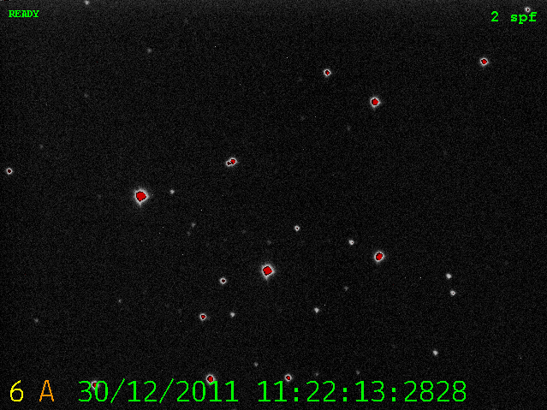
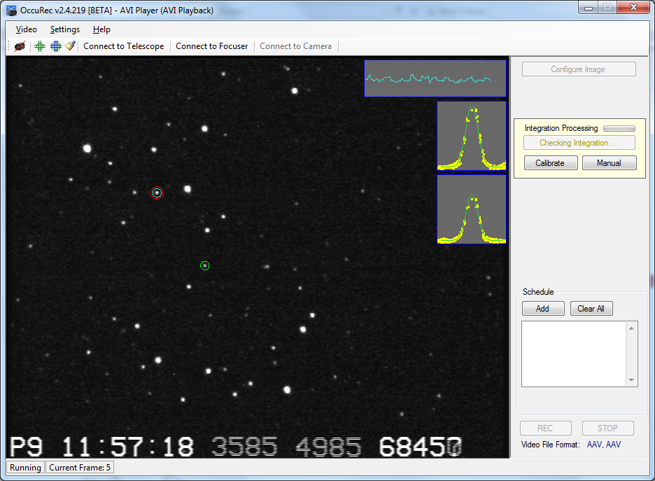
New Video File Formats
Astronomical Digital Video
with ADVS
ADV
AAV
Astronomical Analogue Video
with OccuRec
Notes:
[2:17 – 2:19]
ADV – Efforts to make the file format more widely used with involvement from SER file format consortium

Slide 4

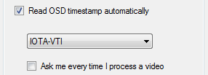
Reading IOTA-VTI Timestamp
Background must not be too bright
All fields and frames must be present
Notes:
[2:19 – 2:23] OCRing is difficult stuff. Well done to LiMovie for supporting 3 different timestamps
Tangra3 at the moment only supports IOTA-VTI
The reading will happen with any frame resolution and aspect

Slide 5
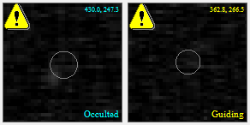
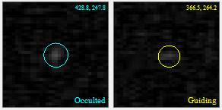
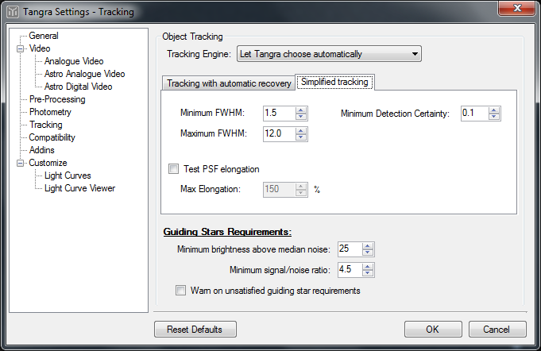
New Tracking Algorithm
Notes:
[2:23 – 2:25] New tracking engine – faster and more accurate for ‘standard’ videos. Old tracking engine was built to handle issues like severe wind, shaking and flickering but wasn’t great for the majority of the ‘normal’ videos.

Slide 6
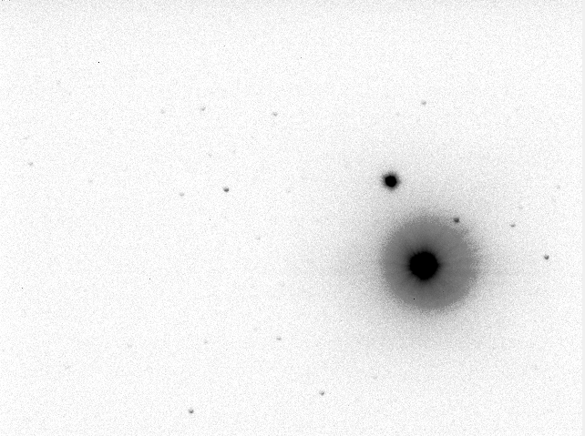
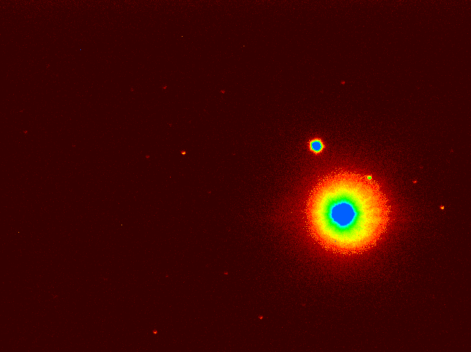
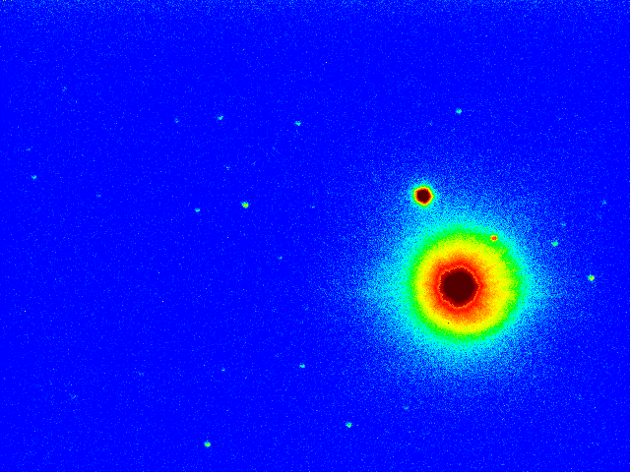
Display ‘Modes’
Notes:
[2:25 – 2:28] New ‘Hue Intensity’ and ‘Inverted’ display modes.

Slide 7
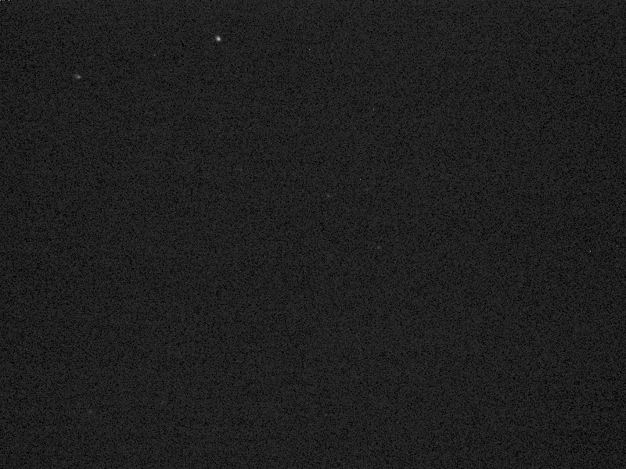
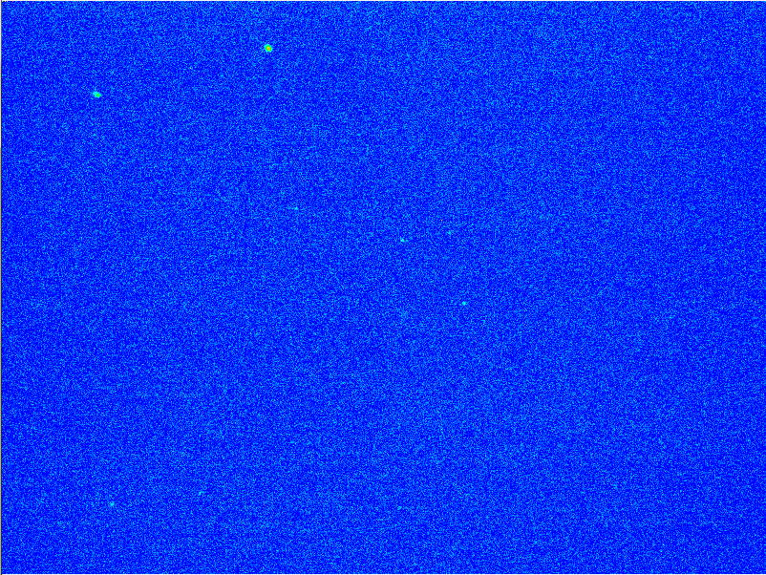
Display Gamma
Notes:
[2:28 – 2:30] New display gamma mode – very useful for 12 and 14 bit videos.

Slide 8
Demo 1
Measuring Different Video Types with Tangra3 and AOTA
Notes:
[2:30 – 2:40] ADV
AAV
AVI – with OCR-ed Timestamps
AVI – with no OCR-ed timestamps

Slide 9
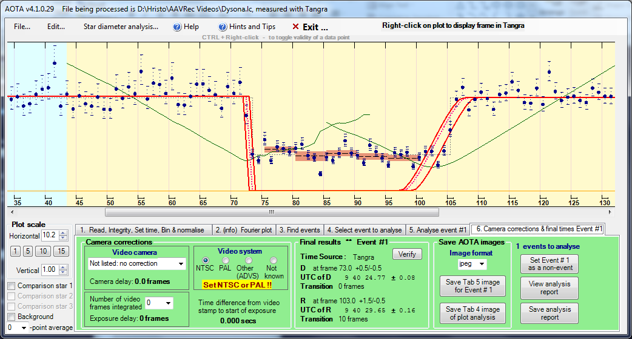
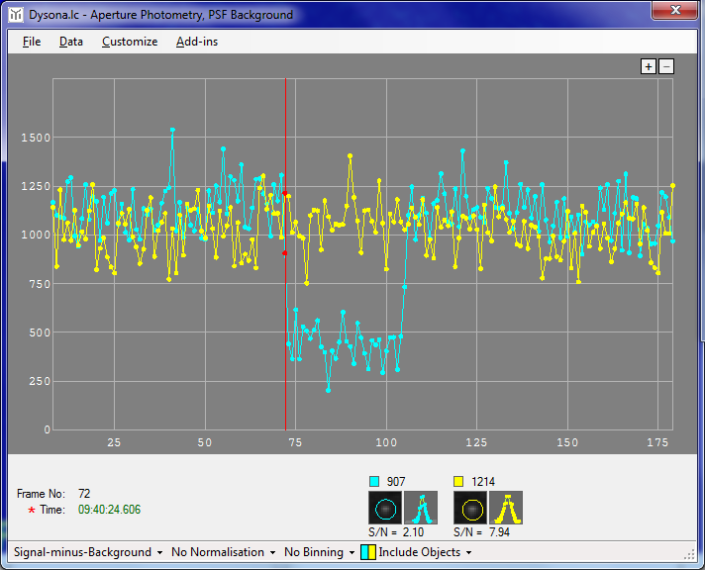
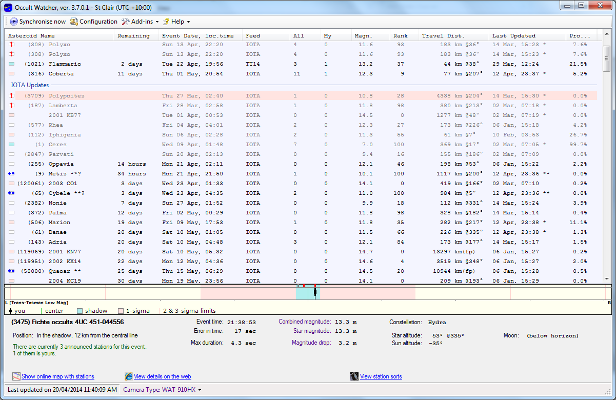
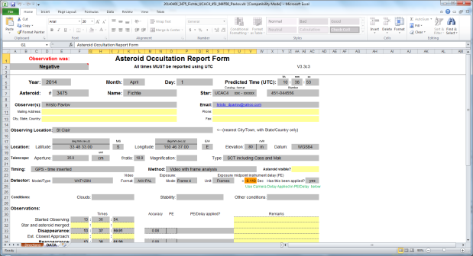
OccultWatcher Integration
C:\Videos\OccVideo_AOTA_Event#1.jpg
C:\Videos\OccVideo_AOTA_Xcorr.jpg
C:\Videos\OccVideo_AOTA_Xcorr.jpg
C:\Videos\OccVideo.trep.xml
C:\Videos\OccVideo.avi
Notes:
[2:40 – 2:42]

Slide 10
Demo 2
Reporting AOTA Measured Results with OccultWatcher
Notes:
[2:42 – 2:45] ADV
AAV
AVI – with OCR-ed Timestamps
AVI – with no OCR-ed timestamps

Slide 11
Demo 3
Running Tangra3 on Linux
Notes:
[2:45 – 2:50] ADV
AAV
AVI – with OCR-ed Timestamps
AVI – with no OCR-ed timestamps

Slide 12
Questions?
http://www.hristopavlov.net/Tangra3
Notes:
[2:50 – 3:00]

